Slide 1

SAP Build Training for Corporate Professionals
DAY-18
www.anubhavtrainings.com

Slide 2


DISCLAIMER
The training content and delivery of this presentation is confidential, and cannot be recorded, or copied and distributed to any third party, without the written consent of Anubhav Trainings

Slide 3
Agenda
Pre-packaged content
Scenario
Integration Suite
Configuring Process

Slide 4






Scenario – Extract SAP S/4HANA Sales order
Citizen Developer
Design and deploy the build business process with process visibility scenario
Sales Representative
Starts the sales order process by providing order no. for approval
Sales Manager
Provides the necessary approval for the sales order
Sales Head
Track the progress of business process and KPIs (transparency)
SAP Build process Automation
SAP Build work zone
Build process
Process Trigger
My Inbox App
Visibility Scenario Dashboard
Requirement
Start the process with order no
Retrieve the order details from S4
Determine the approver based on Sales organization
Allows monitoring of process through key KPIs
orders

Slide 5
Process Visibility
The process visibility capability within the SAP Workflow Management service provides end-to-end visibility and intelligence to processes, which run on cloud, on-premise, and in hybrid environments.
The Process Visibility capability provides visibility on business processes with their extensions to enable process excellence by:
Providing a real-time view of an entire process regardless of the platform it operates on.
Providing actionable insights to steer the process forward.
Providing performance indicators for a business process to understand the current and the past performance.
The capability provides Process Workspace to track processes in real-time, search and filter instances, analyze performance indicators, and view detailed information about an instance.
https://help.sap.com/docs/process-visibility/process-visibility-capability/creating-visibility-scenario
http://s4dev.st.com:8021/sap/opu/odata/sap/API_SALES_ORDER_SRV/A_SalesOrder?$format=json&$filter=TotalNetAmount%20gt%2010000&$select=SalesOrder,SalesOrganization,TotalNetAmount

Slide 6
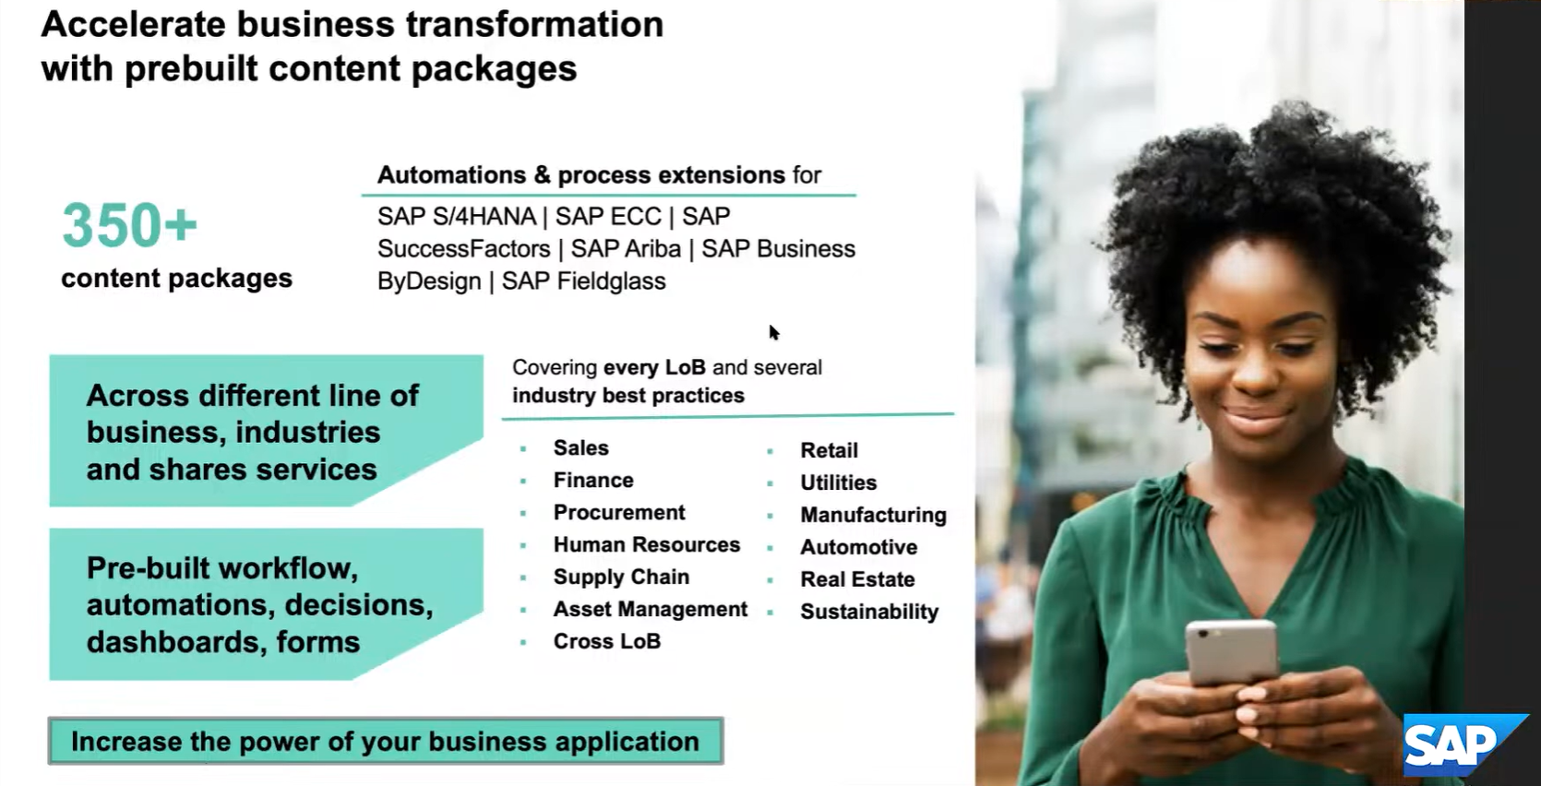
SAP Build Content Package
<content>

Slide 7
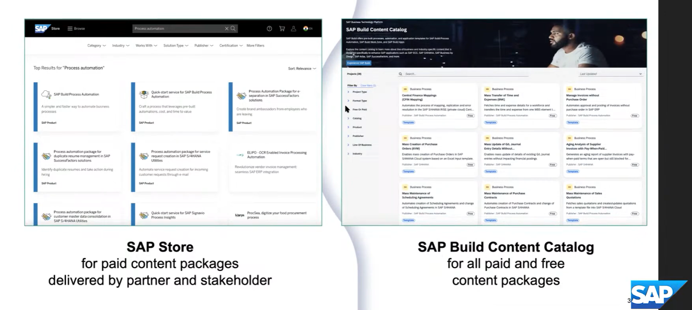

SAP Build content Store
<content>

Slide 8




Scenario Asset Transfer between organization

Slide 9
Overview
SAP Build Process automation
actions
Standard process
SAP Integration Suite
Standard Package
iFlow
SAP BTP Platform
Odata Service destination
RFC destination
SCC
SAP S/4HANA system

Slide 10




























MTA project ID: fixedwriteofftaskui
namespace: com.sap.fixedassettransfers.taskui
Module Name: FixedAssetTransfersTaskUIModule

Slide 11
Start UI
Call to start process
main
Fixed asset transfer approval (main)
us10.3c2f8a17trial.fixedassettransferapproval.fixedAssetTransferApproval
Sender Cost Centre Owner Approval (sub process)
us10.3c2f8a17trial.fixedassettransferapproval.senderCostCenterOwnerApproval
Cost Center owner approval sub process
us10.3c2f8a17trial.fixedassettransferapproval.costCenterOwnerApprovalSubprocess
Post Fixed Asset Transfer
us10.3c2f8a17trial.fixedassettransferapproval.postFixedAssetTransfer

Slide 12
Step1 : Download all the UI templates given by SAP and analyze them.
Step2: Configure the task ui and deploy it, test from process
Step3: Configure and deploy the process
Step4: Configure START UI with the ID of deployed main process, deploy the start UI

Slide 13

What We Did
Let’s Summarize
www.anubhavtrainings.com

Slide 14
www.anubhavtrainings.com
Thank You
End of Day 18
www.anubhavtrainings.com

Slide 15



We’re committed to empower you to be
#FutureReady
through powerful training solutions.
We build the workforce of the future.
250+
Corporate Clients
30,000+
Learners Trained
25000+
Learners Placed
FREE WEBINARS
Sign up for free webinars with industry experts every fortnight!
Enroll Now!
Contact us today!
https://anubhavtrainings.com

